Slide 1
License Plate Localization and Character Recognition
Aman Patel

Slide 2
Problem Statement
License plate OCR is commonly used in parking garages and toll booths to accurately determine the license plate numbers of cars that violate their rules.
How does image segmentation and preprocessing impact the correctness of license plate OCR?

Slide 3
Related Work
One study compared different character recognition neural network algorithms to determine which had the highest correctness.
Another study compared the success rates of a multi-layered perceptron at different stages of processing.

Slide 4
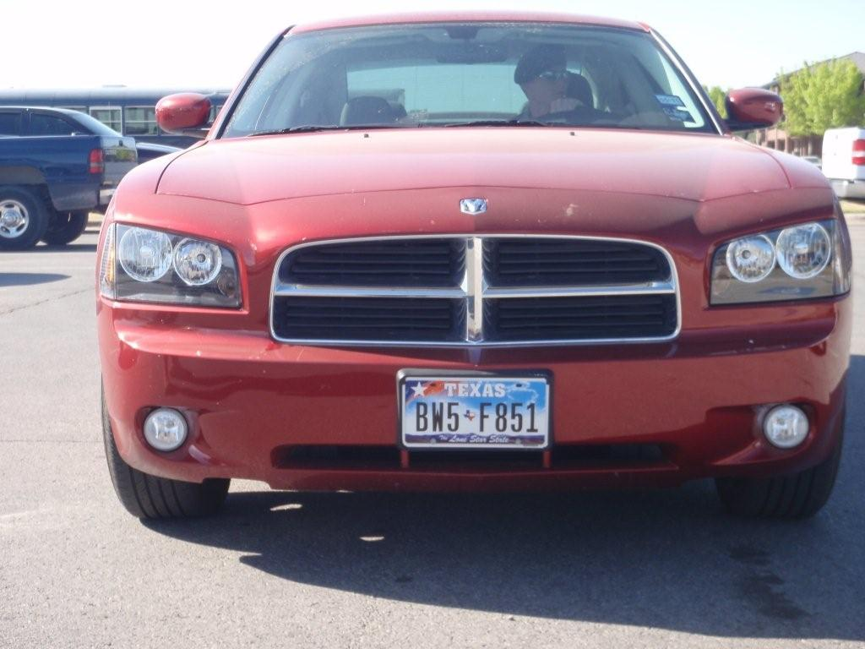
How It Works
Four Major Steps:
Preprocessing
License Plate Localization
Character Segmentation
Character Recognition
Original Image

Slide 5
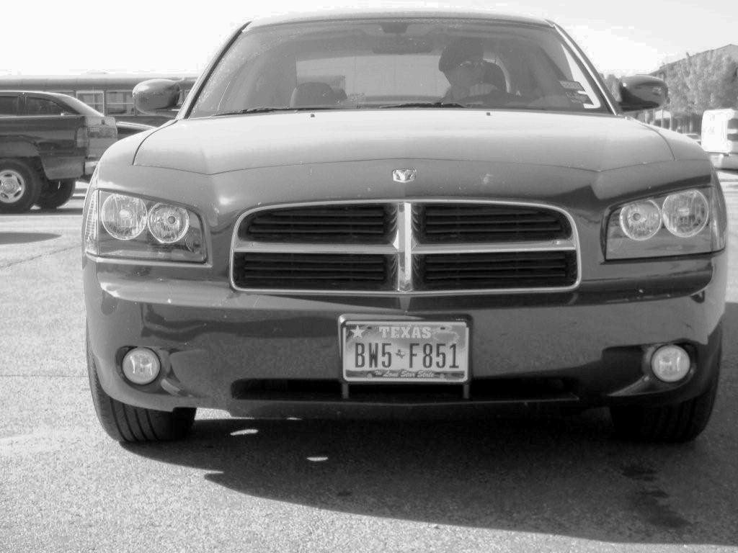
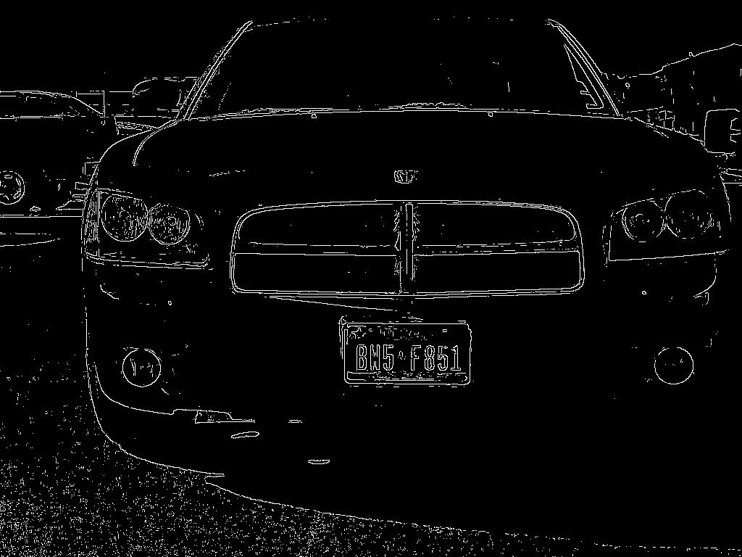
Preprocessing
RGB to Grayscale and Histogram Equalization
Roberts edge detection

Slide 6
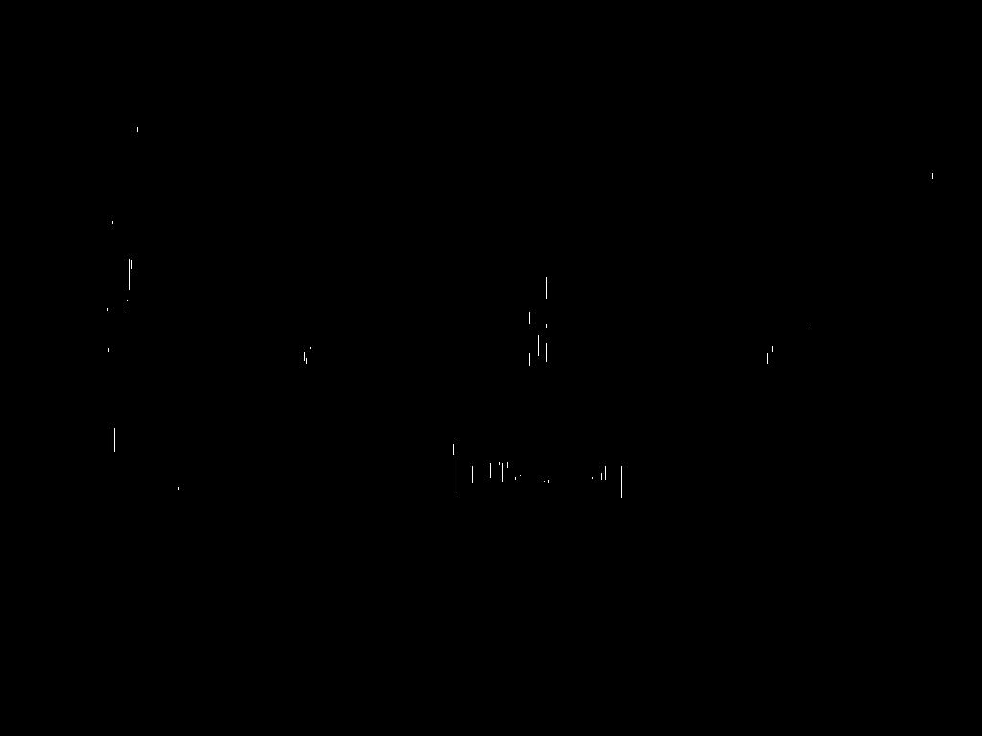
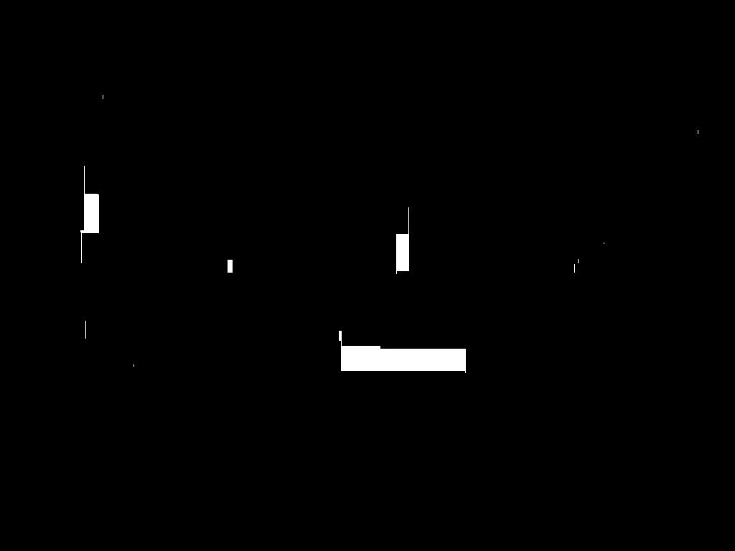
License Plate Localization
Vertical line erosion
Morphological closing

Slide 7

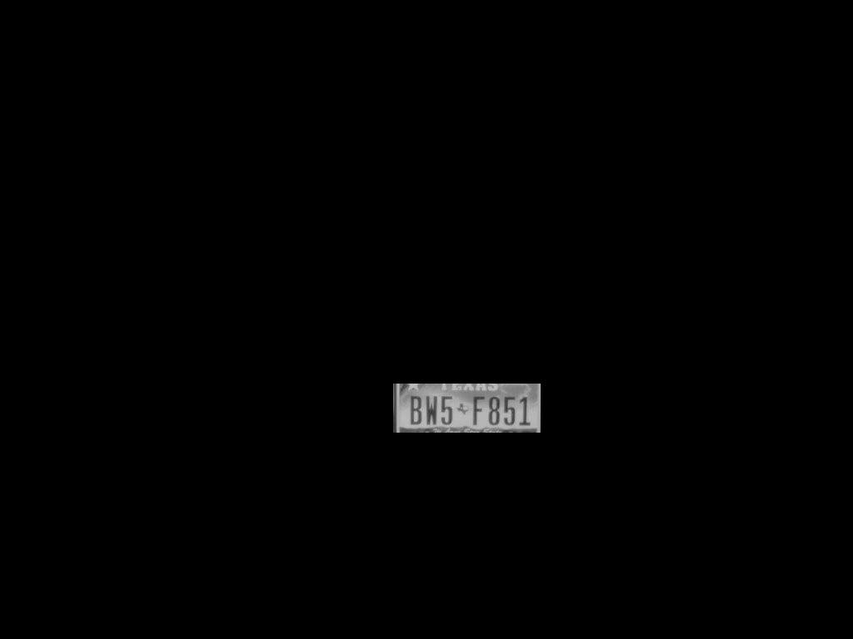
License Plate Localization
Connected Components
Masking

Slide 8



Character Segmentation
Binarization and Denoising
Character Segmentation

Slide 9
Character Recognition
Intention
Each character would be run through a trained character recognition ANN
The correctness of the self-implemented optical character recognition ANN would be compared to the correctness of MATLAB’s built-in OCR function.
Unfortunately, I was unable to get my implementation working by the time of this presentation.
Compromise
The comparison was between applying MATLAB’s OCR to the original image and applying MATLAB’s OCR to the segmented image.

Slide 10
Results
MATLAB’s OCR on Original Image vs. on Localized License Plate Image
Table 1: Application of OCR to Original Image vs. Segmented or Smoothed Image
(the runtimes were measured with imwrite and imshow functions active)
The drastic difference in correctness is due to MATLAB OCR’s inability to distinguish sparse characters in a large RGB image, even with a specified region of interest.
The additional processing resulted in an increase in correctness of 72-74%, with only a 0.09 - 0.1s increase in runtime.
Method | Attempted (characters) | Correct (characters) | Average Runtime (per plate)
OCR Original | 100 | 18 | 2.593s
OCR Segmented | 100 | 90 | 2.685s
OCR Smoothed (improvement) | 100 | 92 | 2.692s

Slide 11
Improvements
Separating letter and number ANNs and comparing the confidences
Increases likelihood of selecting the correct character
Only plausible if initial ANN is functional
Smoothing character edges prior to running them in ANN
Increases likelihood of ANN recognizing the image as a character

Slide 12
Works Cited
Xie, Fei, et al. “A Robust License Plate Detection and Character Recognition Algorithm Based on a Combined Feature Extraction Model and BPNN.” Journal of Advanced Transportation, Hindawi, 26 Sept. 2018, www.hindawi.com/journals/jat/2018/6737314/.
Kocer, H E., and K K. Cevik. "Artificial neural networks based vehicle license plate recognition." Procedia Computer Science. 3rd ed., Elsevier, 2011, pp. 1033-37.
Shunji Mori, Hirobumi Nishida, and Hiromitsu Yamada. 1999. Optical Character Recognition (1st. ed.). John Wiley & Sons, Inc., USA.

